Slide 1
Computer Lab 3:
Hypothesis Testing
Involving Two Variables
SOST20022 Essentials of survey design and analysis 2024-25

Slide 2
Content
Questions about hypothesis testing in R
General steps of conducting data analysis using R
Example: Data Analysis using Scottish Social Attitude Survey, 2016

Slide 3
Questions about hypothesis testing in R
Assumption of Chi-Squared Test
  Warning message: In chisq.test(parish, marital) : Chi-squared approximation may be incorrect
  Each observation is independent of all the others (i.e., one observation per subject);
  No more than 20% of the expected counts are less than 5
  All individual expected counts are 1 or greater
  Alternative: Fisher’s exact test (fisher.test() in R)
Weighting
  Two packages: install.packages(”survey”); install.packages(”weights”); wtd.t.test()
One-sided test
  t.test(x, mu=, alternative=“greater”);
  t.test(x, mu=, alternative=“less”)

Slide 4
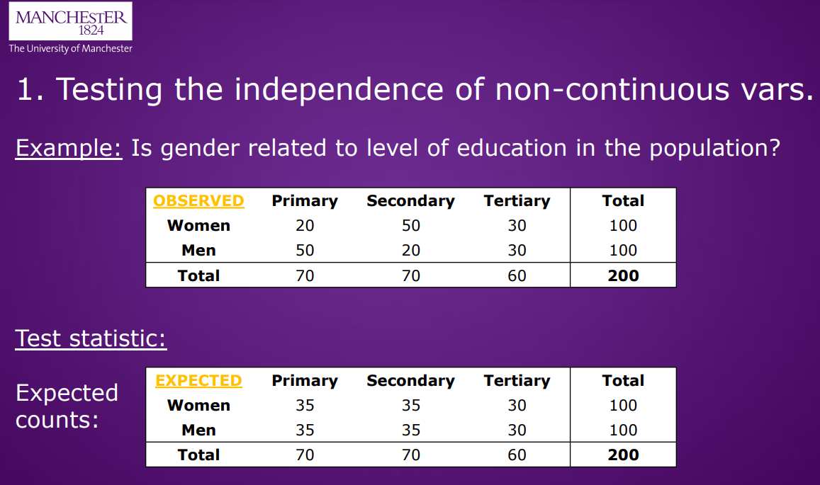

Slide 5
General steps of conducting data analysis using R
1) setting directory/notes/log and read your data
- set.wd()
- read.table()
2) explore your data
- data structure: head(), str(), dim()
- variable: categorical--> table(); barplot(), continuous --> histogram()
3) data cleaning (incorrect data)
- duplicate data; missing values(sum(is.na(var))); outliers (boxplot)
4) data wrangling (meaningful and accessible)
- recoding data, converting level of measurement

Slide 6
General steps of conducting data analysis using R
5) descriptive analysis
- mean(), sd(), sum()
# always have weighting(weighted.mean; weighted.sd; function) and missing (na.rm; is.na) in mind
6) hypothesis testing
- t.test(); chisq.test()
# R. specific
install.packages(""); library()

Slide 7
Example: Data Analysis using Scottish Social Attitude Survey, 2016
  Hypothesis 1: Voting for Scottish Independence (1=Yes, 2=No) and party identification (1=Conservative, 2 =Labour, 3= Liberal Democrat…6=None) are related.
  Hypothesis 2: Voting for Scottish Independence (1=Yes, 2=No) and age (continuous variable) are related.
  Hypothesis 3: A Scottish adult’s weight and age are correlated.
  What hypothesis test should I perform?

Slide 8
More Q&A…

